Slide 1
Prediction of P-gp Efflux within the Blood Brain Barrier Impacting Molecule Transport or Inhibition
Sarah Abu-Salih, PharmD Candidate
Butler University
Mentor: Dr. Amanda Paulson, PhD
2021 ATOM Internship Symposium | July 30, 2021

Slide 2
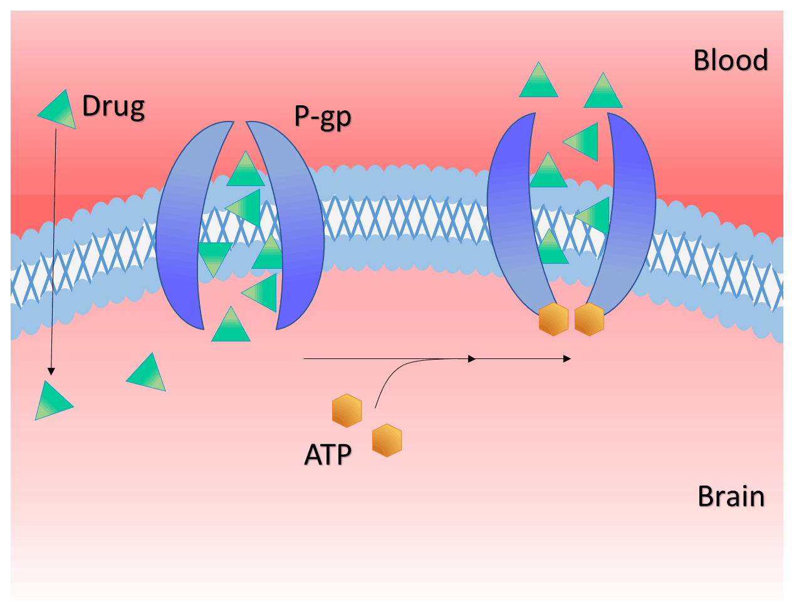
What is P-glycoprotein?
P-gp (ABCB1) is a primary multidrug transporter embedded within plasma membranes, specifically the blood brain barrier.
P-gp utilizes the energy of ATP hydrolysis to pump toxic xenobiotics out of cells.
Figure 1. www.ScienceDirect.com

Slide 3
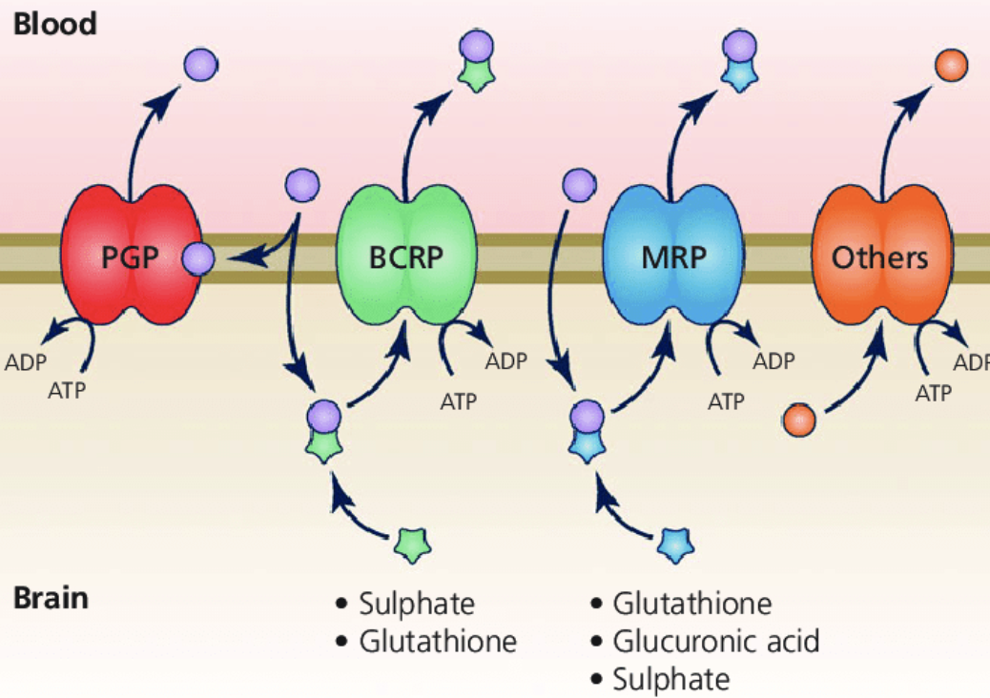
Introduction
P-glycoprotein is responsible for the uptake and efflux of many compounds.
This efflux occurs when drugs are transported from the plasma to the blood brain barrier and are met with P-gp.
A huge challenge for researchers today when creating new anti-cancer drugs is identifying whether the compound will be able to pass the BBB or not.
This can be resolved through utilization of prediction models which help researchers better understand P-gp’s behavior.
Figure 2. https://www.researchgate.net/figure/Efflux-transporters-at-the-blood-brain-barrier-These-are-mainly-ATP-binding-cassette_fig4_325221328

Slide 4
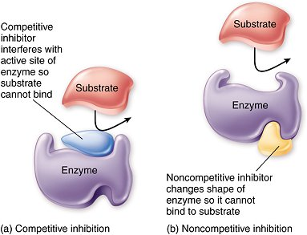
Substrate and Inhibitor Selectivity of P-gp
Substrates of P-gp tend to be hydrophobic cationic molecules.
Using site-directed mutagenesis, multiple binding sites for substrates and inhibitors have been identified on P-gp.
Inhibitors are tested by watching the decrease in the transport of a known P-gp substrate.
If an inhibitor is really good, then the substrate would be transported less!
However, there are two main ways this inhibitor could work: Competitive + Non-Competitive
It is commonly assumed that inhibitors work in a competitive manner, thus making inhibitors and substrates equivalent. However, it has been shown that there is less overlap than expected between inhibitors and substrates for P-gp, so I created separate models for each set of compounds.
Figure 3. www.socratic.org
Notes:
Molecules that repel water and have a positive charge
Script here about competitive vs non-competitive

Slide 5
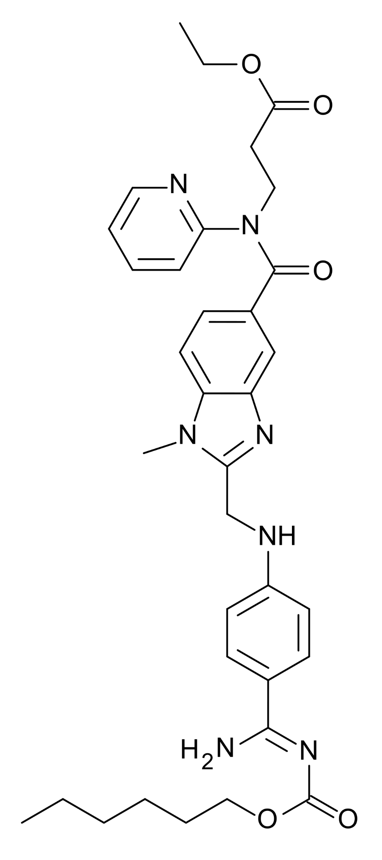
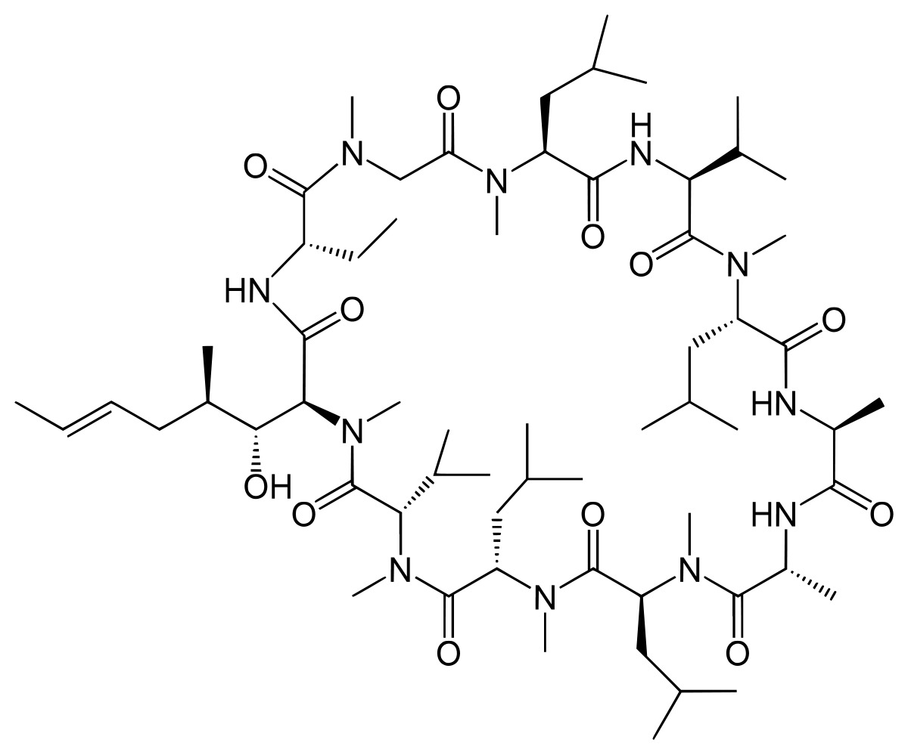
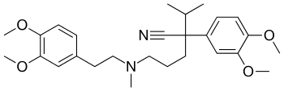
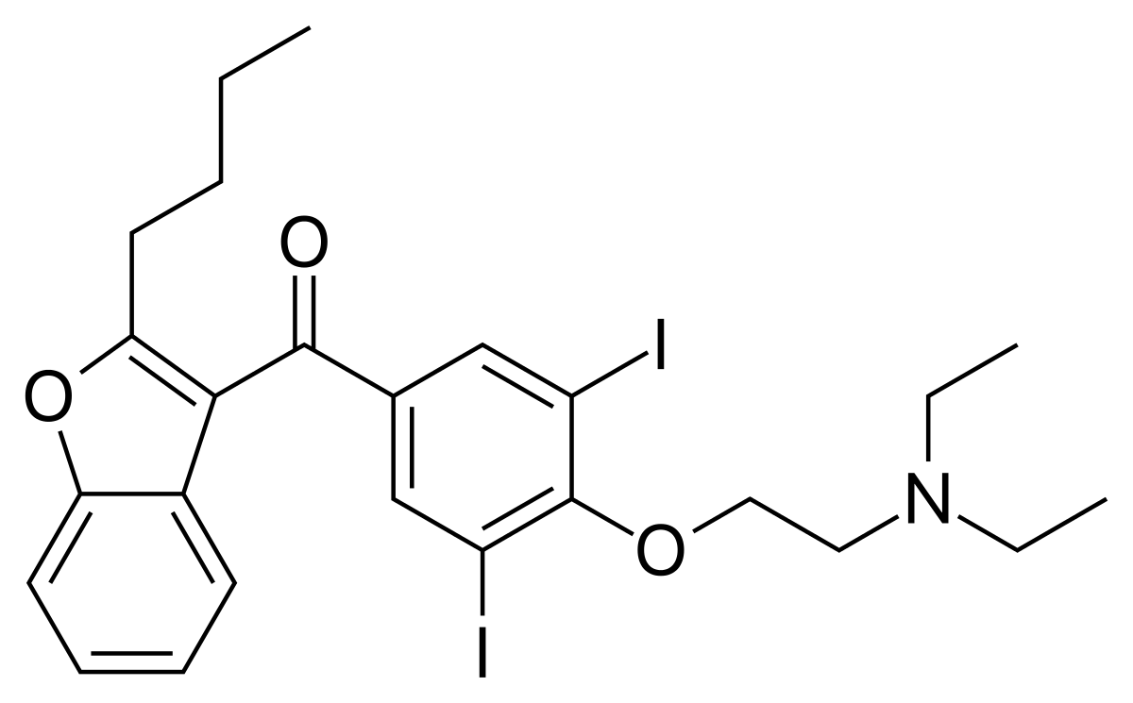
Known Substrates + Inhibitors of P-gp
Substrates
Inhibitors
Verapamil
Cyclosporine
Amiodarone
Dabigatran etexilate
Notes:
Notice how the substrates are large, hydrophobic, and cationic molecules… these are the molecules that would not gain entry to the brain from the plasma because they would be pumped back into the blood by P-gp.
I found it interesting to look at how different the structures were when comparing known P-gp substrates vs. inhibitors

Slide 6
ChEMBL
DTC
Excape
2 published journal articles
Materials & Methods
Accumulated a vast collection of compounds identifying whether the compounds were substrates for Pgp or not
Allows researchers to predict whether a compound will be successful in crossing the BBB based on whether or not a compound is predicted to be a Pgp-efflux substrate
Classification Model
Data Curation + Collection
Values were normalized by taking the negative log of the IC50 values and converting them to pXC50 values
Purpose of the regression model will be to predict a compound’s pXC50 value
Regression Model
ChEMBL
DTC
Excape
Notes:
For the classification model:
When you were assembling these dataframes, did you only use published labels of substrate/non substrate or inhibitor/non-inhibitor, or did you also include all your regression data by setting a threshold pXC50 value to classify them?
Utilized pxc50 values from ChEMBL, DTC, and Excape and set threshold pXC50 value to 8.0 in order to classify them into substrate/non substrate and inhibitor/non-inhibitor.

Slide 7
Final Dataframes
Classification Inhibition (1339 compounds)
Classification Model
Classification Transport (3398 compounds)
Data Curation + Collection
Regression Inhibition (1414 compounds)
Regression Model
Regression Transport (1338 compounds)
Notes:
Through utilization of two published journal articles, I was able to curate more data to be used for my Classification Model.
Inhibitor vs Non-Inhibitor of Pgp (Classification Inhibition)
Substrate vs Non-Substrate of Pgp (Classification Transport)

Slide 8
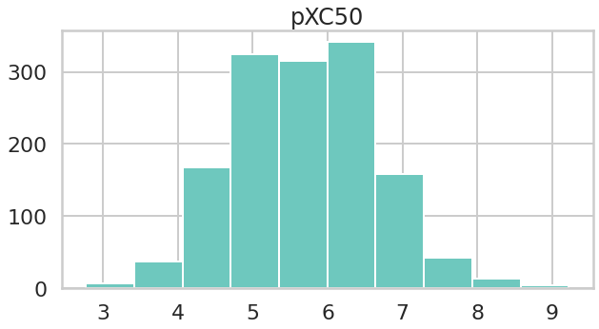
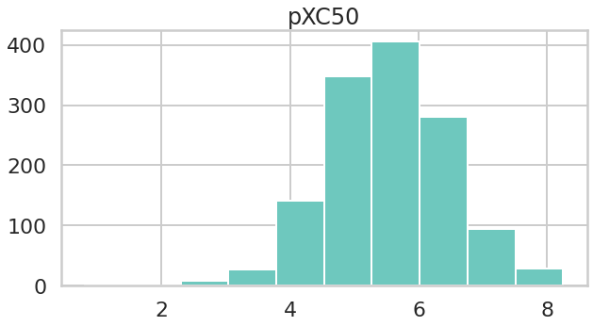
Regression Model Data
Distribution of pXC50 values for Regression Inhibition Model
Distribution of pXC50 values for Regression Transport Model
pXC50 Values
pXC50 Values
Notes:
Helps visualize the pXC50 values that were curated.

Slide 9
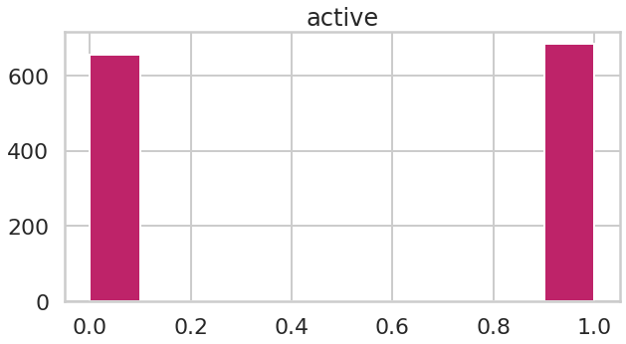
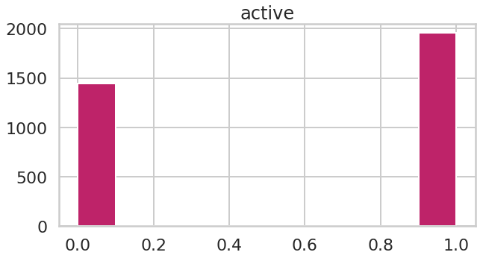
Classification Model Data
Distribution of Inhibitors vs. Non-Inhibitors of P-gp for Classification and Inhibition Model
Distribution of Substrates vs. Non-Substrates of P-gp for Classification and Transport Model
Notes:
Figure 6. The data above represents data curated for Classification and Inhibition model. A value of 0 means the compound was not an inhibitor of Pgp, and a value of 1 means the compound was an inhibitor of Pgp. An even distribution of inhibitors vs non-inhibitors was utilized to create the Classification and Inhibition model.
Figure 7. The data used for the Classification and Transport model was also fairly equally distributed, A value of 0 meant the compound was a non-substrate of Pgp, while a value of 1 means the compound was a substrate for Pgp.

Slide 10
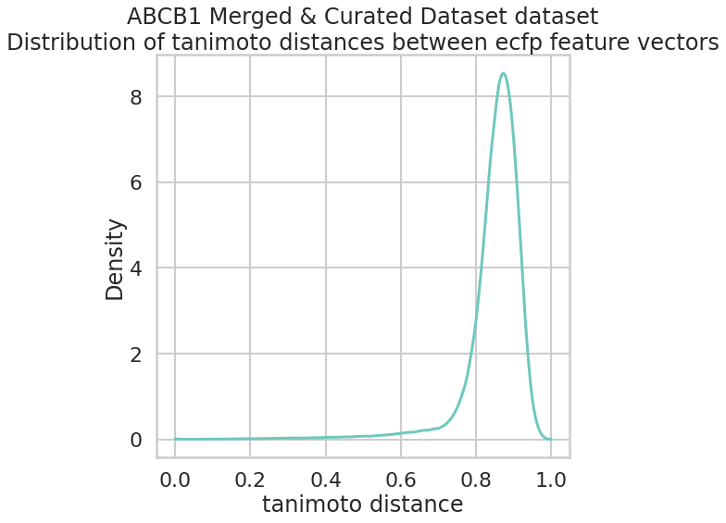
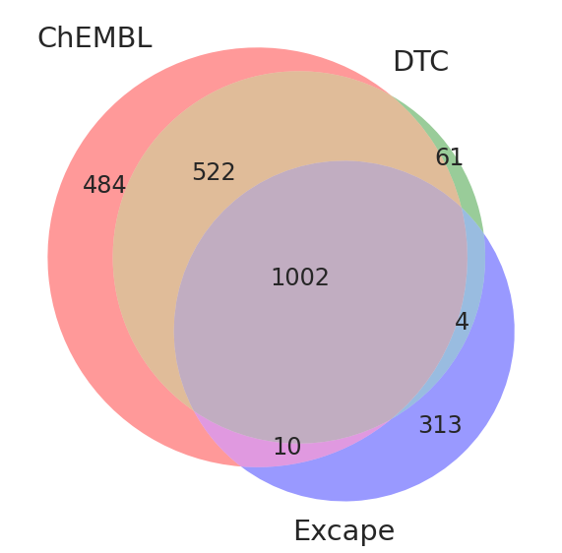
Diversity of Data
Figure 4. Overlap of smiles strings within data acquired from ChEMBL, DTC, and Excape.
Figure 5. Distribution of tanimoto distances between ecfp feature vectors using combined and curated data from ChEMBL, DTC, and Excape.

Slide 11
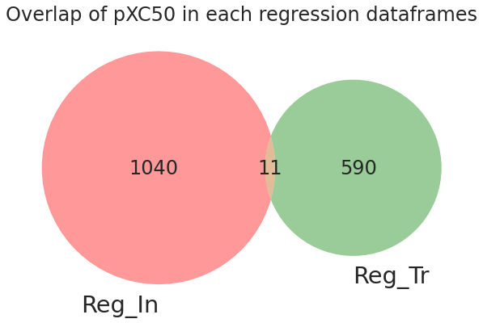
Regression Model Data
Overlap of SMILES Strings Between Regression Dataframes
Notes:
This overlap is interesting because of what i mentioned earlier about how strong inhibitors can also be considered substrates if they act competitively. As we see here, only 11 compounds had overlapping SMILES strings, meaning there’s a fair amount of non-overlapping compounds in comparison. This demonstrates how differently substrates and inhibitors interact with pgp.

Slide 12
Modeling
RDKit
ECFP
Neural Network
Features
Models
Random Forest
MOE
XGBoost
Mordred Filtered
GCN

Slide 13
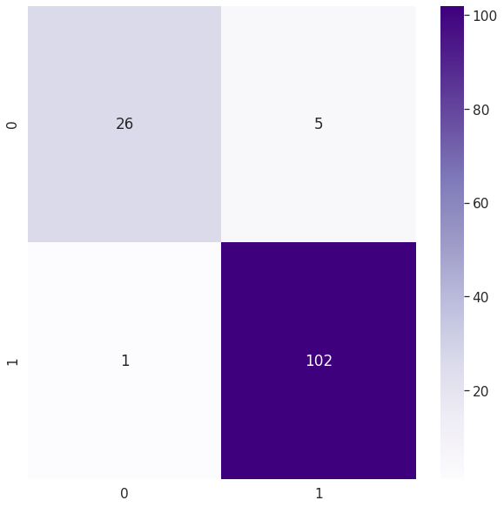
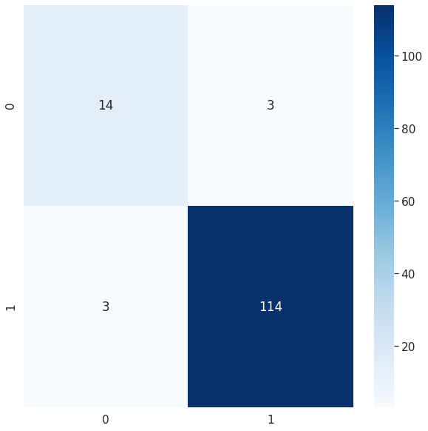
Classification Inhibition Results
Best model performance for Classification + Inhibition:
RDKit + Random Forest
valid_roc_auc_score: 0.974
Confusion Matrix for Validation Set
Confusion Matrix for Test Set
Notes:
We used the validation set to assess the model’s performance
26 true positives and 100 true negatives; 5 false positives and 1 false negative
The test set was data that the model had never seen before, so it’s exciting to see there’s only 6 false results.
14 true positives, 114 true negatives; 3 false positives and 3 false negatives

Slide 14
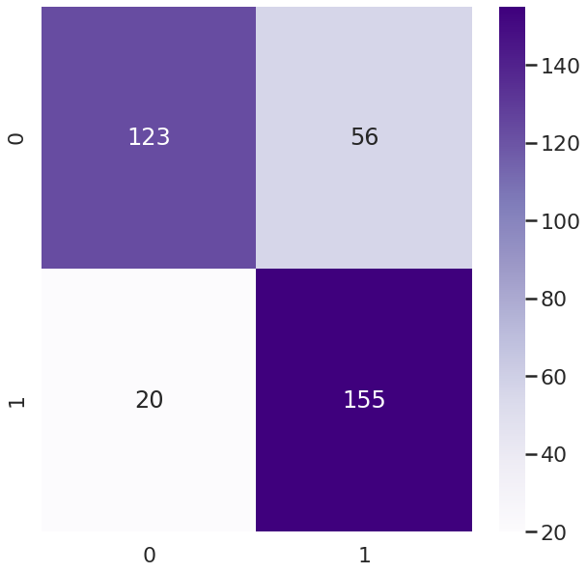
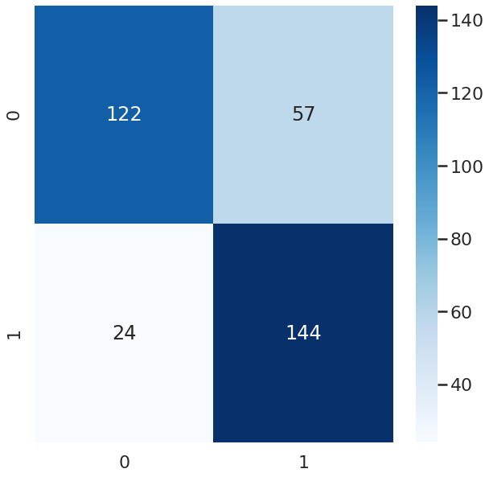
Classification Transport Results
Best model performance for Classification + Transport:
MOE + Random Forest
valid_roc_auc_score: 0.863
Confusion Matrix for Validation Set
Confusion Matrix for Test Set
Notes:
We used the valid set to assess the model’s performance
123 true positives and 155 true negatives; 56 false positives and 20 false negatives
The test set was data that the model had never seen before, so it’s exciting to see there’s only 6 false results.
122 true positives, 144 true negatives; 57 false positives and 24 false negatives

Slide 15
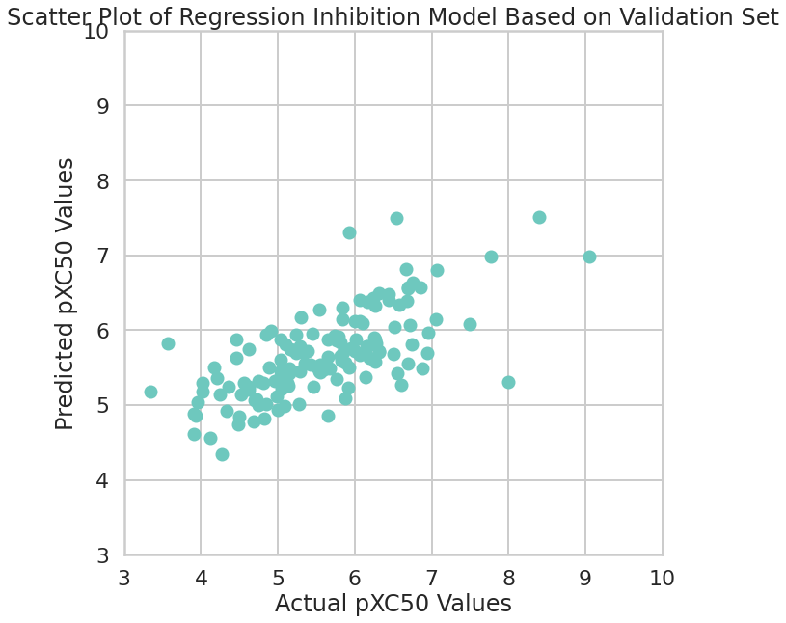
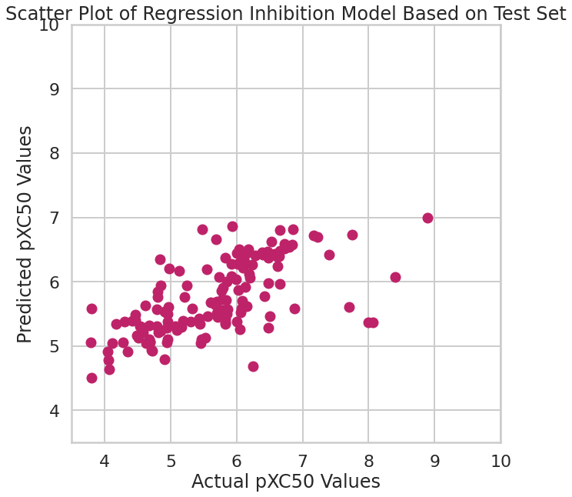
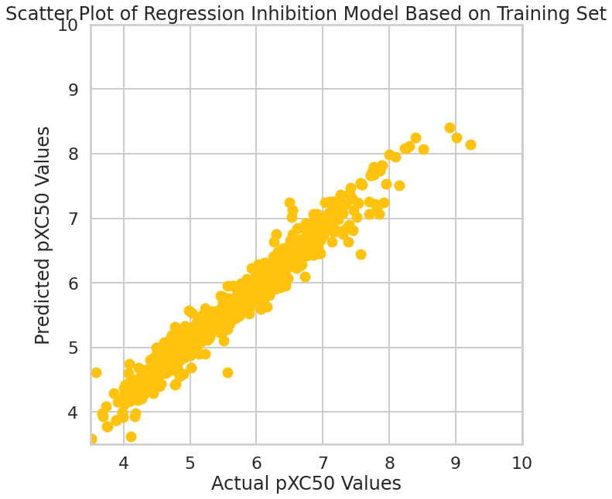
Regression Inhibition Results
Best model performance for Regression + Inhibition:
RDKit + Random Forest
r2_score: 0.448
Notes:
"Scatter Plot of Regression Inhibition Model Based on Validation Set"
Explanation:

Slide 16
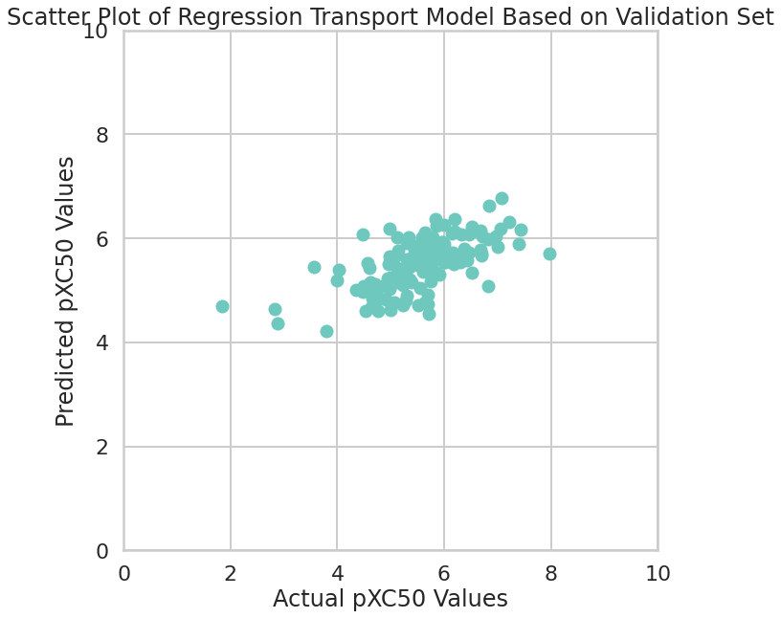
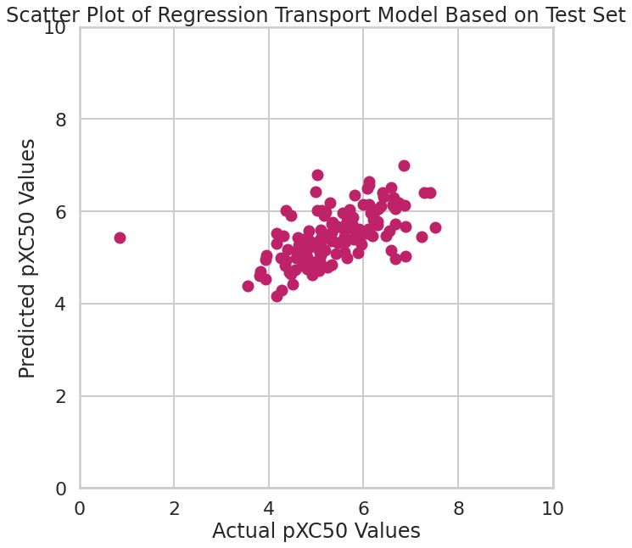
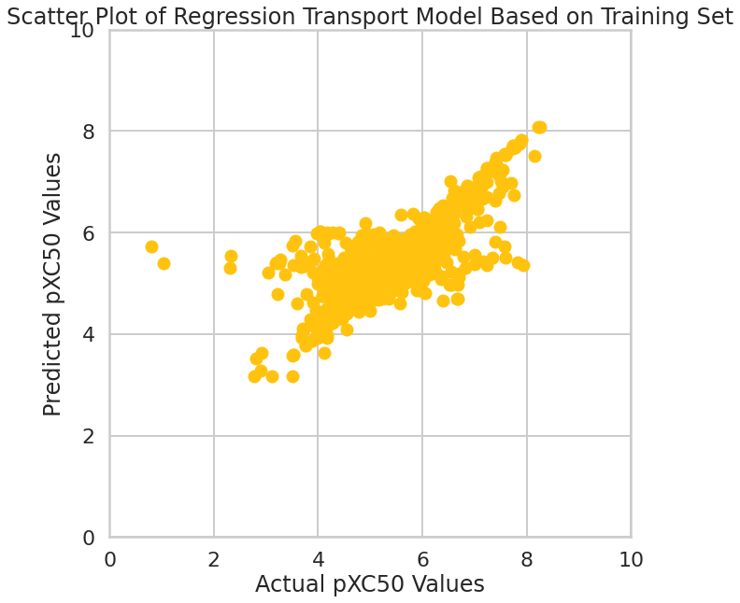
Regression Transport Results
Best model performance for Regression + Transport:
Mordred Filtered + Random Forest
r2_score: 0.385
Notes:
"Scatter Plot of Regression Transport Model Based on Validation Set"

Slide 17
Conclusion
For all 4 of the different data frames, my highest scoring models were Random Forest
Classification inhibition data: RDKit + Random Forest
Classification transport data: MOE + Random Forest
Regression inhibition data: RDKit + Random Forest
Regression transport data: Mordred Filtered + Random Forest

Slide 18
Future Aims
Improve the regression models
The scores for my regression models were significantly lower than the scores of my classification models
Find more data to work with in order to build more efficient regression models!

Slide 19
Acknowledgements
Amanda Paulson, Ph.D.
Susan Mertins, Ph.D
Caleb Class, Ph.D
Sarangan Ravichandran, Ph.D.
Da Shi, Ph.D.
Fellow ATOM summer interns ☻

Slide 20
Works Cited
ChEMBL Database. EBI. https://www.ebi.ac.uk/chembl/g/#search_results/targets/query=abcb1. Accessed July 13, 2021.
H2020 ExCAPE. ExCAPE-DB: ExCAPE chemogenomics database. https://solr.ideaconsult.net/search/excape/. Accessed July 13, 2021.
Sedykh A, Fourches D, Duan J, et al. Human intestinal transporter database: QSAR modeling and virtual profiling of drug uptake, efflux and interactions. Pharm Res. 2013;30(4):996-1007. doi:10.1007/s11095-012-0935-x
Shaikh N, Sharma M, Garg P. Selective Fusion of Heterogeneous Classifiers for Predicting Substrates of Membrane Transporters. J Chem Inf Model. 2017 Mar 27;57(3):594-607. doi: 10.1021/acs.jcim.6b00508. Epub 2017 Mar 6. PMID: 28228010.

